Slide 1


CAPSTONE PROJECT
Road Accident Data Analysis using Power BI
Presented By
Student Name: Abhishek Kumar
College Name: Sir Chhotu Ram Institute of Engineering and Technology, Meerut
Department: MCA
Email ID: ak14972@gmail.com

Slide 2
OUTLINE:
Problem Statement
Proposed System/Solution
System Development Approach
Algorithm & Deployment
Result
Conclusion
Future Scope
References

Slide 3
Problem Statement:
Road accidents are a major concern in many countries and cities. A large number of accidents occur every year due to factors such as over-speeding, poor road conditions, and traffic violations.
Analyzing accident data manually is difficult because the dataset contains a large amount of information including location, vehicle type, accident severity, and time.
Therefore, there is a need for a system that can analyze road accident data and present meaningful insights to help authorities improve road safety and reduce accident rates.

Slide 4
Proposed Solution:
The proposed system focuses on analyzing road accident data using Power BI and presenting insights through interactive dashboards.
The system includes the following steps:
Data Collection
Collect accident datasets containing details such as accident date, location, vehicle type, and accident severity.
Data Cleaning & Preprocessing
Remove missing values and prepare the dataset for analysis using Power Query.
Data Analysis
Analyze accident trends such as accident frequency by location, vehicle type, and time.
Data Visualization
Create interactive charts and dashboards using Power BI.
Decision Support
The dashboard will help authorities identify accident hotspots and take preventive measures.

Slide 5
System Development Approach:
System Requirements
• Computer with Windows OS • Microsoft Power BI Desktop • Road Accident Dataset • Internet connection
Tools & Technologies Used
• Power BI • Data Analytics • Data Visualization • Excel / CSV dataset
Power BI Features Used
• Power Query for data cleaning • DAX for calculated measures • Interactive dashboards and filters

Slide 6
Algorithm & Deployment
The project uses a data analytics approach in Power BI to analyze road accident data and generate meaningful insights through visual dashboards.
1. Data Input
The system takes a road accident dataset as input containing information such as:
• Accident Date and Time • Location of Accident • Vehicle Type • Number of Casualties • Accident Severity
2. Data Processing
The dataset is processed using Power BI tools:
• Data cleaning using Power Query • Removing missing and inconsistent data • Creating calculated columns and measures using DAX • Structuring the data for analysis
3. Data Visualization
Different visualizations are created to analyze accident trends:
• Bar charts for accident distribution • Pie charts for severity analysis • Line charts for accident trends over time • Slicers and filters for interactive analysis
4. Deployment
The final dashboard is deployed in Power BI Desktop and can be published to Power BI Service to share insights and monitor accident data in real time.

Slide 7
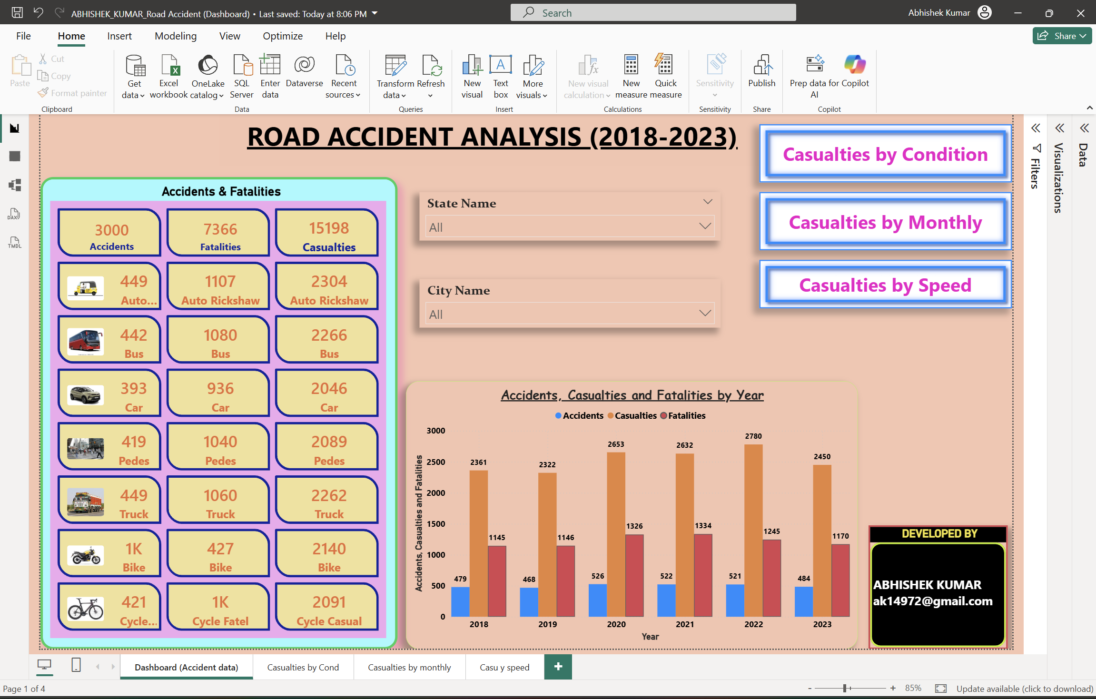
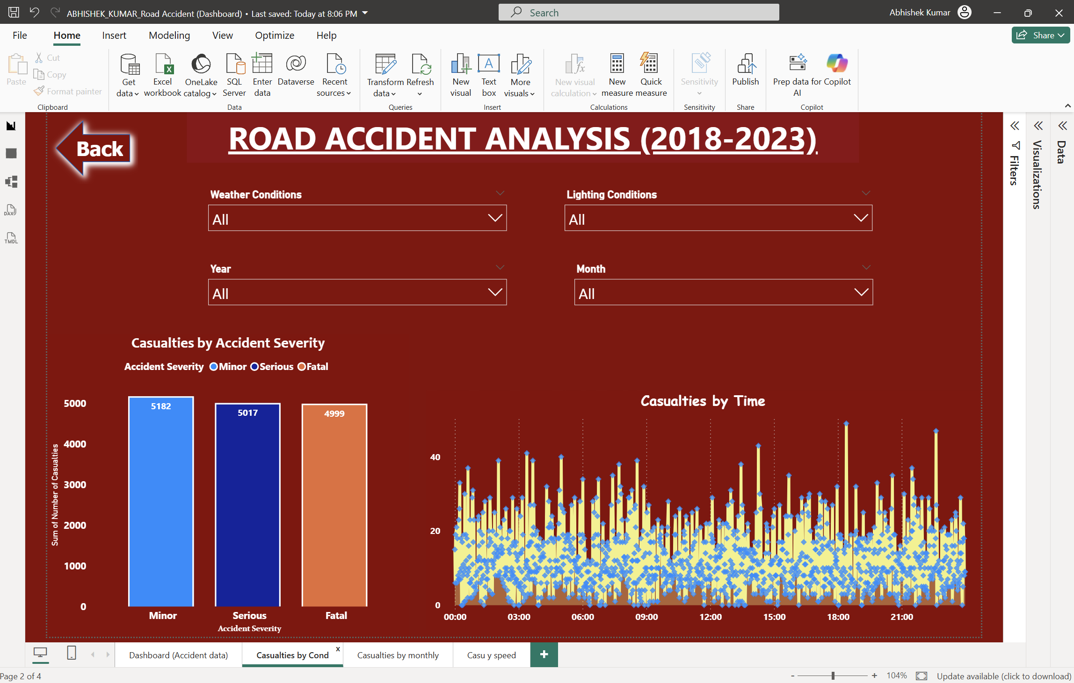
Result:

Slide 8
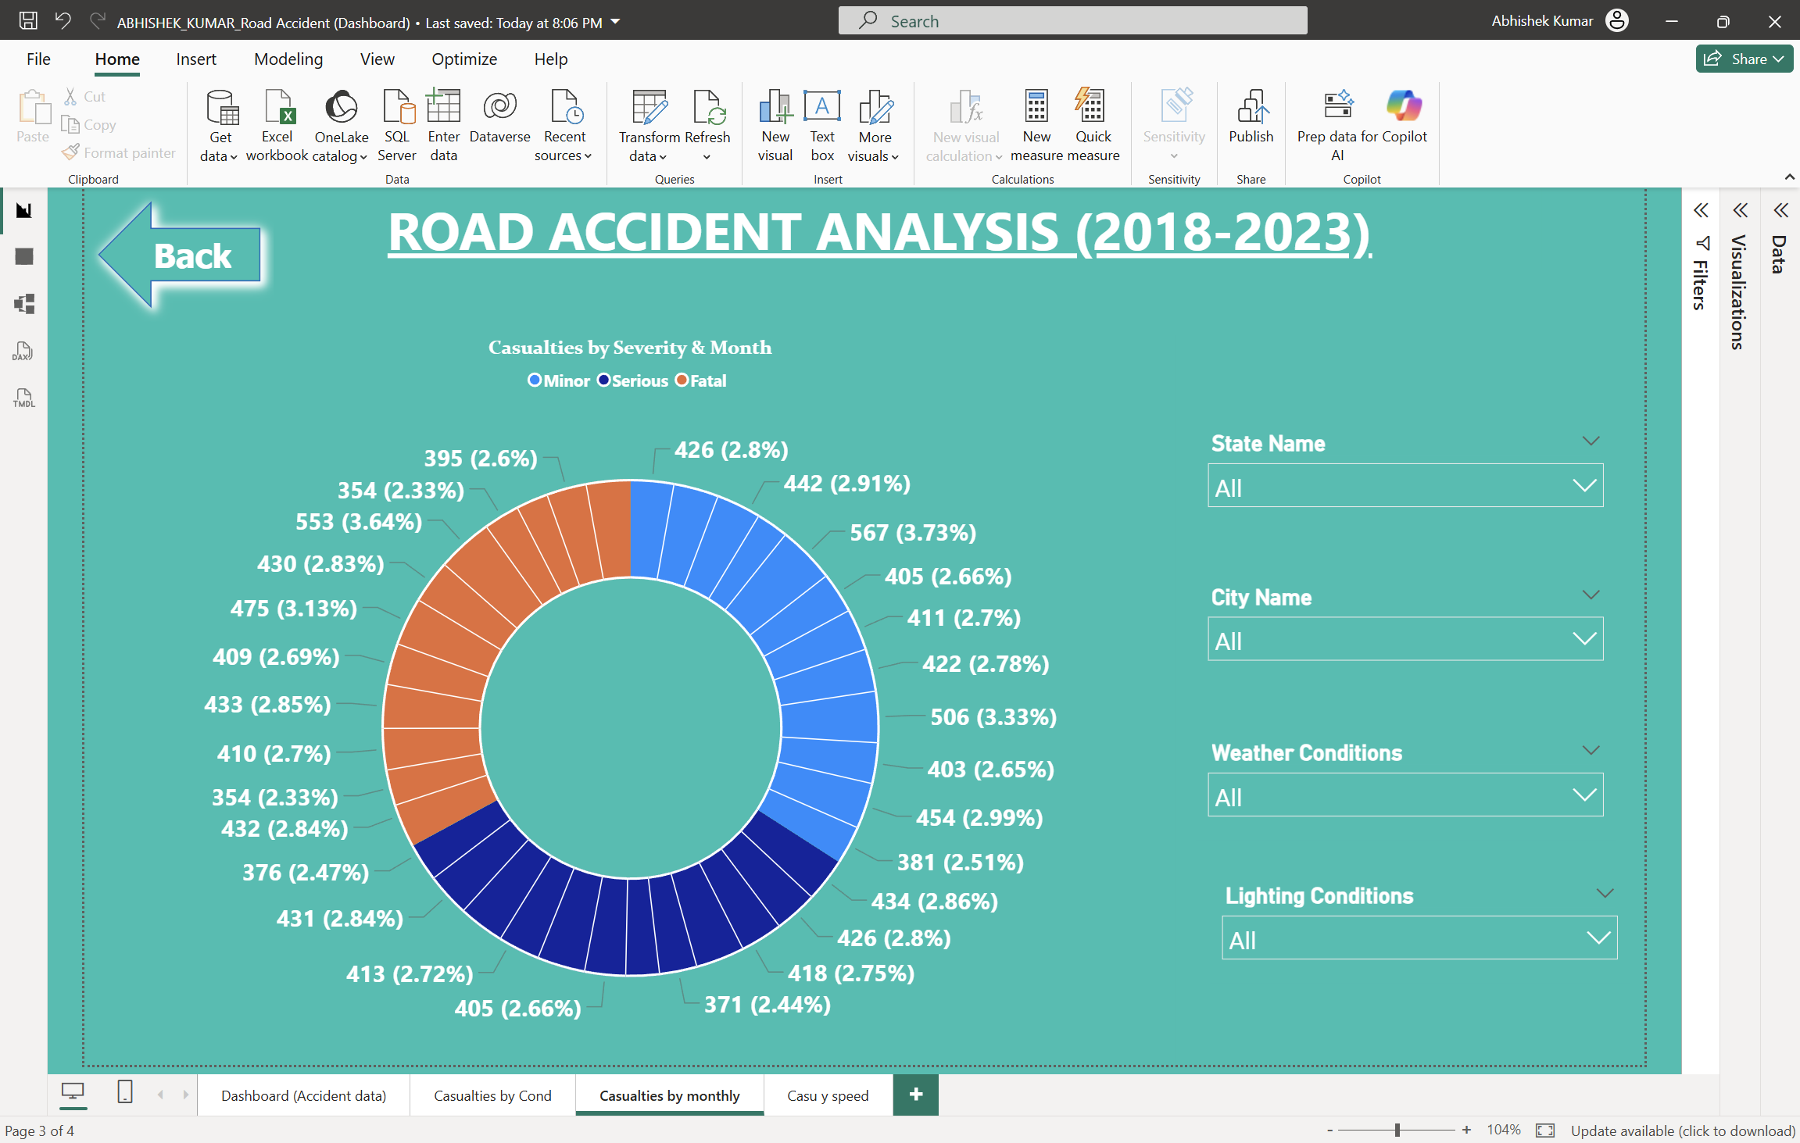
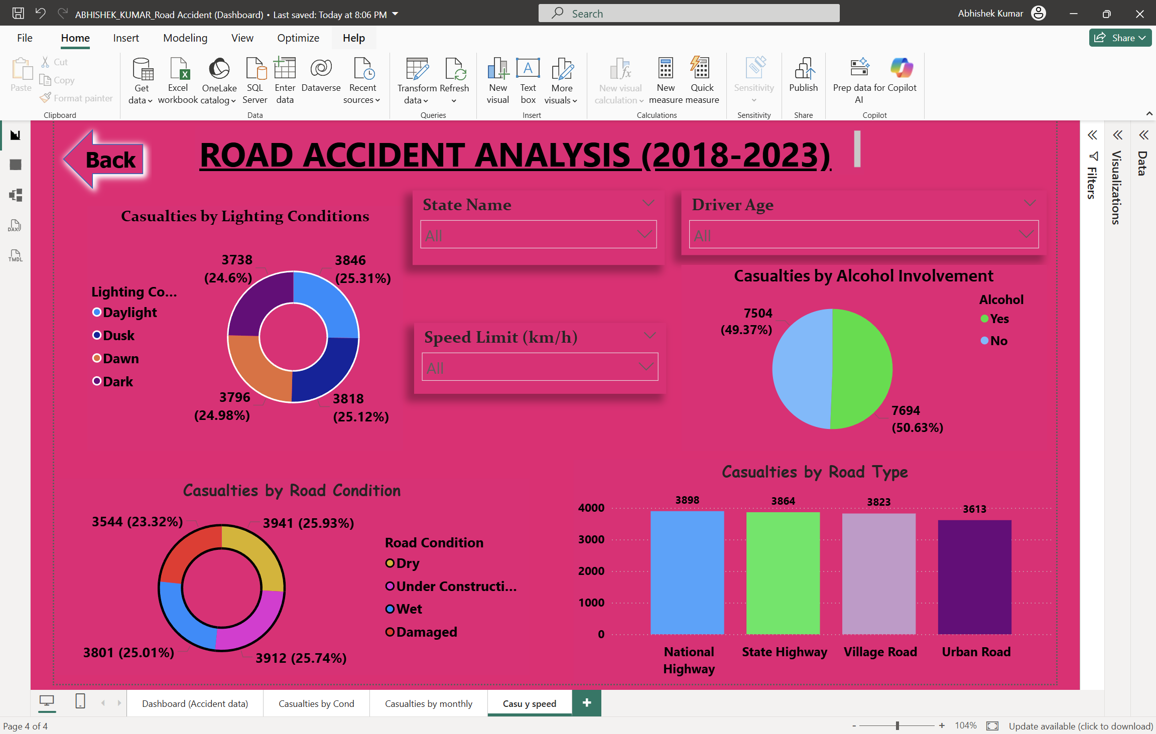
Result:

Slide 9
Result:
The developed Power BI dashboard successfully analyzes road accident data and presents the insights through interactive visualizations.
The dashboard displays important information such as:
• Total number of accidents • Accident severity distribution • Accidents by vehicle type • Accidents by location • Monthly accident trends
The visualizations help users easily understand accident patterns and identify high-risk areas. Interactive filters and charts allow users to explore the dataset and gain meaningful insights for improving road safety.

Slide 10
Conclusion:
The Road Accident Data Analysis project demonstrates how data analytics and visualization tools can be used to analyze large accident datasets and extract meaningful insights.
By using Power BI, the raw accident data is transformed into interactive dashboards that clearly show accident trends, severity levels, and vehicle involvement. These visualizations make it easier to understand accident patterns and identify high-risk areas.
The project highlights the importance of data-driven decision making in improving road safety. With the help of such dashboards, authorities and decision makers can analyze accident data efficiently and take preventive measures to reduce accidents in the future.

Slide 11
Future scope:
The current project focuses on analyzing historical road accident data using Power BI dashboards. In the future, the system can be enhanced with more advanced technologies and data sources to improve road safety analysis.
Possible future improvements include:
• Real-Time Data Integration – Integrating real-time traffic and accident data to monitor accidents instantly.
• Predictive Analytics – Using machine learning models to predict accident-prone areas and high-risk time periods.
• GIS Mapping Integration – Integrating geographic information systems (GIS) to visualize accident locations on maps for better spatial analysis.
• Mobile Dashboard Application – Developing a mobile-friendly dashboard for traffic authorities to monitor accident data anytime.
• Smart Traffic Management – Using accident data insights to support smarter traffic management systems and road safety planning.

Slide 12
References:
The following resources and materials were used for completing this project:
• Microsoft Power BI Documentation – Official Microsoft documentation for learning Power BI features, data modeling, and dashboard creation.
• Road Accident Dataset – Dataset used for analyzing accident patterns, severity levels, and vehicle involvement.
• Data Analytics and Visualization Resources – Online tutorials and learning materials related to data analysis and visualization techniques.
• Microsoft Learn Platform – Learning resources for Power BI and data analytics concepts.
GitHub Link: Link

Slide 13
Thank You

